Slide 1
Perfectly Matched Layers for FDTD

Slide 2
Absorbing Boundaries
- Mur absorbing boundaries work great for 1D
- For 2D and 3D simulations, we need something better

Slide 3
Absorbing Boundaries
Perfectly matched layer (PML)
A thin, fictitious material that absorbs light that approaches the boundary

Slide 4
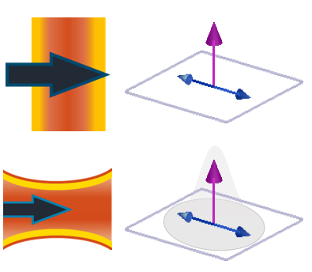
Absorbing Boundaries
Perfectly matched layer (PML)
A thin, fictitious material that absorbs light that approaches the boundary
PML = Absorbing material
nanoparticle

Slide 5
Absorbing Boundaries
Perfectly matched layer (PML)
A thin, fictitious material that absorbs light that approaches the boundary
PML = Absorbing material
But how do we add loss?
nanoparticle

Slide 6

Maxwell’s Equations with loss
$$μ_{0}\frac{∂H_{z}}{∂t} =\frac{∂E_{x}}{∂y}$$
$$ε_{0}ε\frac{∂E_{x}}{∂t}=\frac{∂H_{z}}{∂y}+J_{x}$$
Add a current density!

Slide 7

Maxwell’s Equations with loss
$$μ_{0}\frac{∂H_{z}}{∂t} =\frac{∂E_{x}}{∂y}$$
$$ε_{0}ε\frac{∂E_{x}}{∂t}=\frac{∂H_{z}}{∂y}−J_{x}$$
$$J_{x}=σE_{x}$$
Electric conductivity – controls “how much loss”

Slide 8

Maxwell’s Equations with loss
$$ε_{0}ε\frac{∂E_{x}}{∂t}=\frac{∂H_{z}}{∂y}−σE_{x}$$
How does this cause loss?

Slide 9

Maxwell’s Equations with loss
$$ε_{0}ε\frac{∂E_{x}}{∂t}=\frac{∂H_{z}}{∂y}−σE_{x}$$
$$\frac{∂E_{x}}{∂t}\sim −\frac{σ}{ε_{0}ε}E_{x}$$
Ignore this for a second

Slide 10

Maxwell’s Equations with loss
$$ε_{0}ε\frac{∂E_{x}}{∂t}=\frac{∂H_{z}}{∂y}−σE_{x}$$
$$\frac{∂E_{x}}{∂t}\sim −\frac{σ}{ε_{0}ε}E_{x}$$
$$E_{x} \sim \exp\left[−\frac{σ}{ε_{0}ε}t\right]$$
Ignore this for a second
*This is a very rough explanation of loss, and should not be taken as rigorous

Slide 11


Finite Different approximation
$$ε_{0}ε\frac{∂E_{x}}{∂t}=\frac{∂H_{z}}{∂y}−σE_{x}$$
$H_{z}(t+\frac{Δt}{2})$

Slide 12



Finite Different approximation
$$ε_{0}ε\frac{∂E_{x}}{∂t}=\frac{∂H_{z}}{∂y}−σE_{x}$$
Needs to be at $(t+\frac{Δt}{2})$
Needs to be at $(t+\frac{Δt}{2})$
$H_{z}(t+\frac{Δt}{2})$

Slide 13

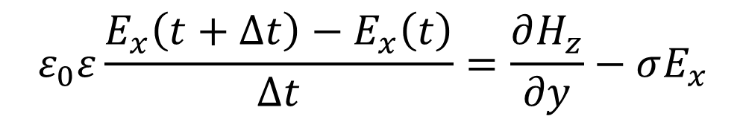


Finite Different approximation
$$ε_{0}ε\frac{E_{x}\left(t+Δt\right)−E_{x}\left(t\right)}{Δt}=\frac{∂H_{z}}{∂y}−σE_{x}$$
Centered at $(t+\frac{Δt}{2})$
Needs to be at $(t+\frac{Δt}{2})$
$H_{z}(t+\frac{Δt}{2})$

Slide 14
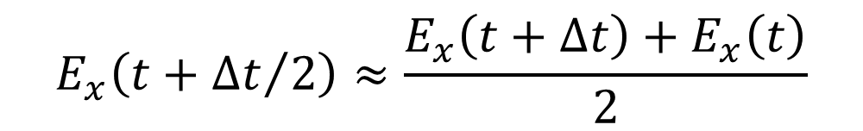
Finite Different approximation
$$E_{x}\left(t+{Δt}/2\right)≈\frac{E_{x}\left(t+Δt\right)+E_{x}\left(t\right)}{2}$$
Linear Interpolation

Slide 15


Finite Different approximation
$$ε_{0}ε\frac{E_{x}\left(t+Δt\right)−E_{x}\left(t\right)}{Δt} =\frac{∂H_{z}(t+{Δt}/2)}{∂y}−σ\frac{{E_{x}\left(t+Δt\right)+E}_{x}\left(t\right)}{2}$$
Finite difference centered at $(t+\frac{Δt}{2})$
Linear interpolation centered at $(t+\frac{Δt}{2})$

Slide 16
Finite Different approximation
$$ε_{0}ε\frac{E_{x}\left(t+Δt\right)−E_{x}\left(t\right)}{Δt} =\frac{∂H_{z}(t+{Δt}/2)}{∂y}−σ\frac{{E_{x}\left(t+Δt\right)+E}_{x}\left(t\right)}{2}$$
$$E_{x}\left(t+Δt\right)\left[\frac{ε_{0}ε}{Δt}+\frac{σ}{2}\right]=E_{x}\left(t\right)\left[\frac{ε_{0}ε}{Δt}−\frac{σ}{2}\right]+\frac{∂H_{z}}{∂y}$$

Slide 17


Finite Different approximation
$$E_{x}\left(t+Δt\right)=cE_{x}\left(t\right)+d\frac{∂H_{z}}{∂y}$$
$$c=\frac{\left[\frac{ε_{0}ε}{Δt}−\frac{σ}{2}\right]}{\left[\frac{ε_{0}ε}{Δt}+\frac{σ}{2}\right]}$$
$$d=\frac{1}{\left[\frac{ε_{0}ε}{Δt}+\frac{σ}{2}\right]}$$

Slide 18

Finite Different approximation
Index notation
$$E_{x}\left(n+1,j\right)=cE_{x}\left(n,j\right)+\frac{d}{Δy}\left[H_{z}\left(n,j\right)−H_{z}\left(n,j−1\right)\right]$$
$$c=\frac{\left[\frac{ε_{0}ε}{Δt}−\frac{σ}{2}\right]}{\left[\frac{ε_{0}ε}{Δt}+\frac{σ}{2}\right]}$$
$$d=\frac{1}{\left[\frac{ε_{0}ε}{Δt}+\frac{σ}{2}\right]}$$

Slide 19

Magnetic conductivity?
For the PMLs to work we also need magnetic field loss
$$μ_{0}\frac{∂H_{z}}{∂t} =\frac{∂E_{x}}{∂y}−σ^{∗}H_{z}$$

Slide 20

$$μ_{0}\frac{∂H_{z}}{∂t} =\frac{∂E_{x}}{∂y}−σ^{∗}H_{z}$$
$$μ_{0}\frac{H_{z}\left(t+Δt/2\right)−H_{z}\left(t−Δt/2\right)}{Δt} =\frac{∂E_{x}(t)}{∂y}−σ^{∗}\frac{{H_{z}\left(t+{Δt}/2\right)+H}_{z}\left(t−{Δt}/2\right)}{2}$$

Slide 21
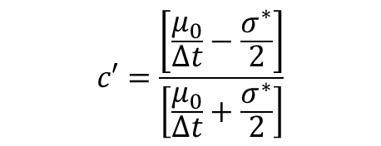
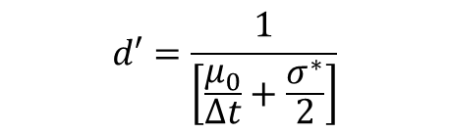
$$μ_{0}\frac{∂H_{z}}{∂t} =\frac{∂E_{x}}{∂y}−σ^{∗}H_{z}$$
$$H_{z}\left(n+1/2,j\right)=c′H_{z}\left(n−1/2,j\right)+\frac{d′}{Δy}\left[E_{x}\left(n,j\right)−E_{x}\left(n,j−1\right)\right]$$
$$c′=\frac{\left[\frac{μ_{0}}{Δt}−\frac{σ^{∗}}{2}\right]}{\left[\frac{μ_{0}}{Δt}+\frac{σ^{∗}}{2}\right]}$$
$$d′=\frac{1}{\left[\frac{μ_{0}}{Δt}+\frac{σ^{∗}}{2}\right]}$$

Slide 22


Algorithm
s$et:$ $c,d,c^{′},d′$
for $n=0→n_{max}:$
Update Magnetic field (n+1/2)
for $j=0→j_{max}−1:$
$$H_{z}\left(n,j\right)=c′H_{z}\left(n−1,j\right)+\frac{d′}{Δy}\left[E_{x}\left(n,j+1\right)−E_{x}\left(n,j\right)\right]$$
Update Electric field (n+1)
for $j=1→j_{max}−1:$
$$E_{x}\left(n+1,j\right)=cE_{x}\left(n,j\right)+\frac{d}{Δy}\left[H_{z}\left(n,j\right)−H_{z}\left(n,j−1\right)\right]$$

Slide 23

Naïve PML
Absorbing material $σ$, ${ σ}^{∗}$
nanoparticle
How do we pick $σ$ and $σ^{∗}$?

Slide 24
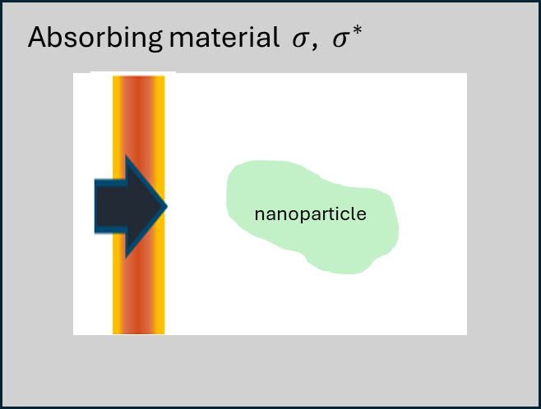
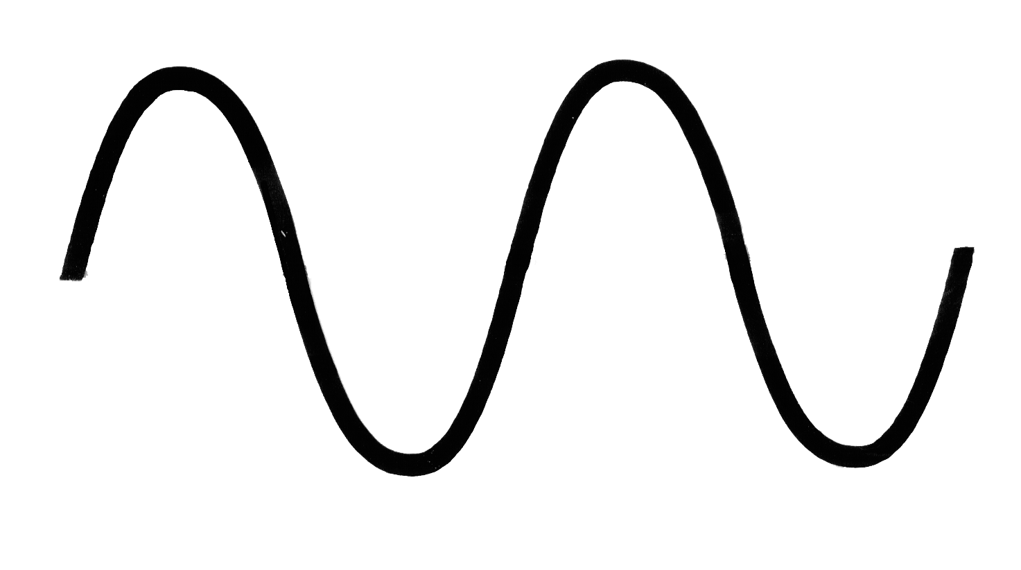


Naïve PML
Dielectric material $ε_{1}$
Absorbing material $ε_{2},$ $σ$, ${ σ}^{∗}$
Incoming field

Slide 25
Naïve PML
Dielectric material $ε_{1}$
Absorbing material $ε_{2},$ $σ$, ${ σ}^{∗}$
Incoming field
Reflected field

Slide 26
Naïve PML
Dielectric material $ε_{1}$
Absorbing material $ε_{2},$ $σ$, ${ σ}^{∗}$
Incoming field
Reflected field
We want no reflection!

Slide 27
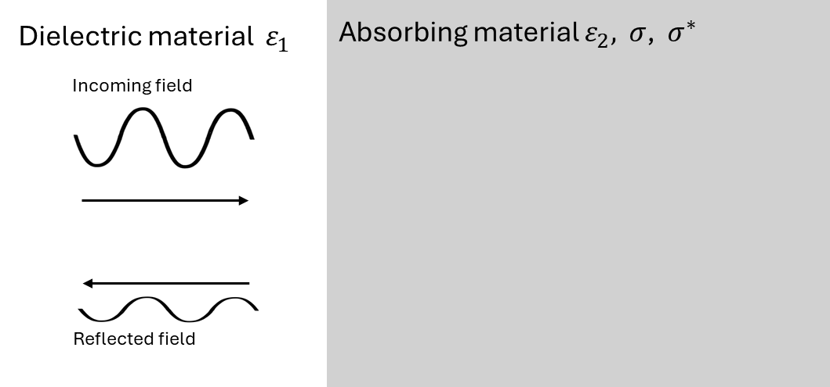

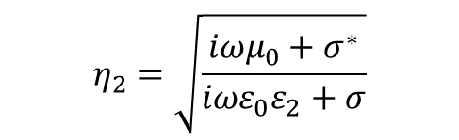
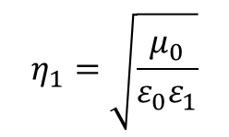
Naïve PML
$$R={\left|\frac{η_{1}−η_{2}}{η_{1}+η_{2}}\right|}^{2}$$
Reflectance
$$η_{1}=\sqrt{\frac{μ_{0}}{ε_{0}ε_{1}}}$$
$$η_{2}=\sqrt{\frac{{iωμ}_{0}+σ^{∗}}{iωε_{0}ε_{2}+σ}}$$
Impedances

Slide 28
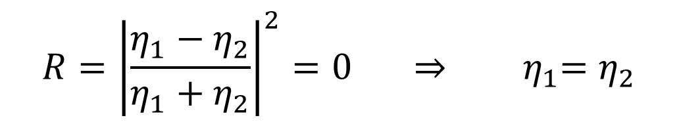
Naïve PML
$$R={\left|\frac{η_{1}−η_{2}}{η_{1}+η_{2}}\right|}^{2}=0 ⇒ { η}_{1}=η_{2}$$
We need to impedances to perfectly match

Slide 29



Naïve PML
$$R={\left|\frac{η_{1}−η_{2}}{η_{1}+η_{2}}\right|}^{2}=0 ⇒ { η}_{1}=η_{2}$$
$$⇒ ε_{1}=ε_{2}$$
$$⇒ σ^{∗}=σ\frac{μ_{0}}{ε_{0}ε_{1}}$$
$$η_{2}=\sqrt{\frac{{iωμ}_{0}+σ^{∗}}{iωε_{0}ε_{2}+σ}}$$
These are our conditions for a naïve PML
$$η_{1}=\sqrt{\frac{μ_{0}}{ε_{0}ε_{1}}}$$

Slide 30


Naïve PML
$$⇒ ε_{1}=ε_{2}$$
$$⇒ σ^{∗}=σ\frac{μ_{0}}{ε_{0}ε_{1}}$$
How do we pick $σ$?

Slide 31

Naïve PML
Electric field in a PML:
$$E_{x}\left(y\right) \sim e^{−iky−σy/cε_{0}}$$

Slide 32

Naïve PML
Electric field in a PML:
$$E_{x}\left(y\right) \sim e^{−iky−σy/cε_{0}}$$
$${\left|E_{x}\left(y\right)\right|}^{2} \sim e^{−2σy/{cε}_{0}}$$

Slide 33

Naïve PML
Electric field in a PML:
$${\left|E_{x}\left(y\right)\right|}^{2} \sim e^{−2σy/{cε}_{0}}$$
We want ${\left|E_{x}\left(y=l_{pml}\right)\right|}^{2}$ to be a very small number $δ$

Slide 34
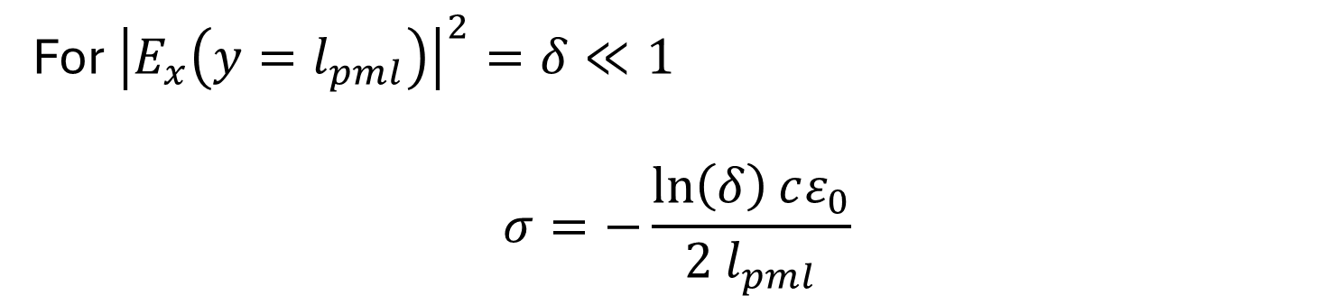

Naïve PML
Electric field in a PML:
$${\left|E_{x}\left(y\right)\right|}^{2} \sim e^{−2σy/{cε}_{0}}$$
For ${\left|E_{x}\left({y=l}_{pml}\right)\right|}^{2}=δ≪1$
$$σ=−\frac{\ln\left(δ\right)cε_{0}}{2 l_{pml}}$$

Slide 35
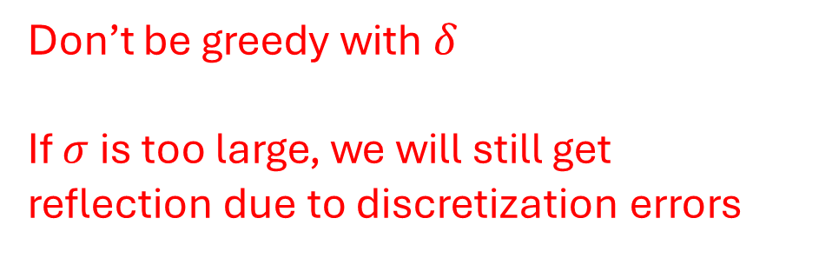

Naïve PML
$$σ=−\frac{\ln\left(δ\right)c_{0}ε_{0}}{2 n l_{pml}}$$
Don’t be greedy with $δ$
If $σ$ is too large, we will still get reflection due to discretization errors

Slide 36




Code Break
Reflection monitor
Mur B.C.
$$ε_{0}$$
$$σ,σ^{∗}$$
$$j_{source}$$
$$l_{PML}$$

Slide 37
Naïve PML limitations
The reflection is still non-negligible
Our analysis assumes light is at normal incidence
In 1D that’s fine

Slide 38

Simple adaptations
use graded $σ$ instead of constant:
$$σ\left(y\right)=σ_{max}{\left(\frac{y}{l_{pml}}\right)}^{m}$$

Slide 39

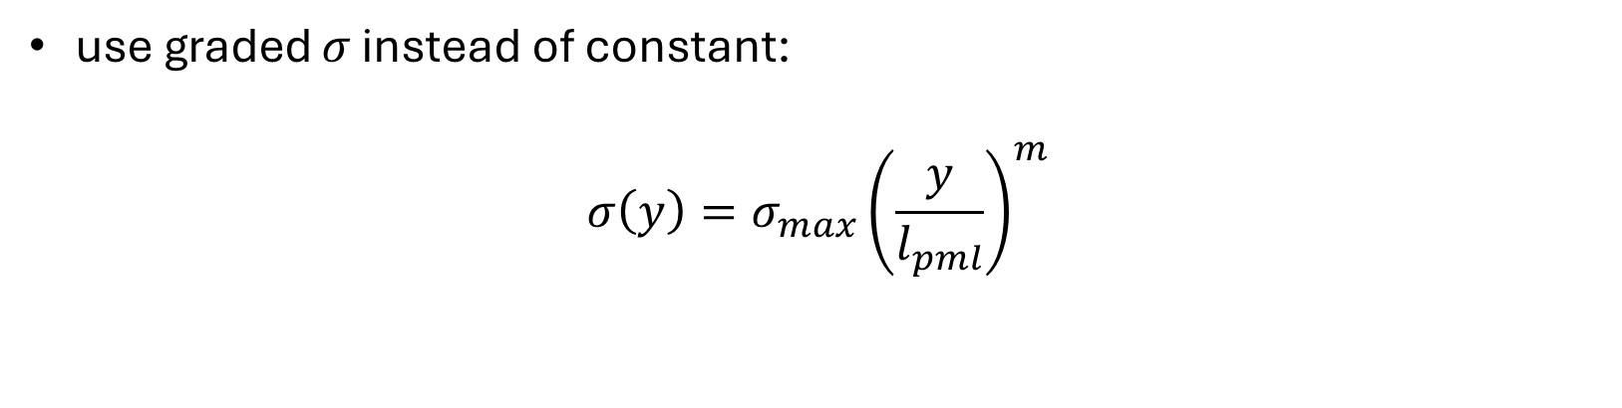
Simple adaptations
use graded $σ$ instead of constant:
$$σ\left(y\right)=σ_{max}{\left(\frac{y}{l_{pml}}\right)}^{m}$$
$$σ_{max}=−\frac{\left(m+1\right)\ln\left(δ\right)cε_{0}}{2 n l_{pml}}$$

Slide 40


Code Break
Reflection monitor
Mur B.C.
$$ε_{0}$$
$$σ\left(y\right),σ^{∗}\left(y\right)$$
$$j_{source}$$
$$l_{PML}$$

Slide 41
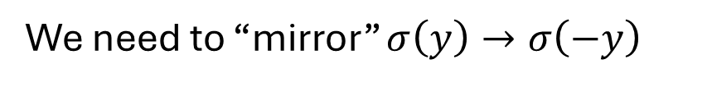



Code Break
We need to “mirror” $σ\left(y\right)→σ\left(−y\right)$
$$σ\left(y\right),σ^{∗}\left(y\right)$$
$$σ\left(y\right),σ^{∗}\left(y\right)$$
$$l_{PML}$$
$$j_{source}$$
$$l_{PML}$$

Slide 42
Naïve PML limitations
The reflection is still non-negligible
Our analysis assumes light is at normal incidence
Not good for 2D and 3D simulations

Slide 43


Naïve PML limitations
The reflection is still non-negligible
Our analysis assumes light is at normal incidence
Not good for 2D and 3D simulations
$$R\left(θ=0\right)={\left|\frac{η_{1}−η_{2}}{η_{1}+η_{2}}\right|}^{2}=0$$
Incoming field
$$R\left(θ\right)$$
Reflected field

Slide 44

Stretched-coordinate formulation
Electric field in a PML:
$$E_{x}\left(y\right) \sim e^{−iky−kσy/ωε_{0}}$$

Slide 45

Stretched-coordinate formulation
Electric field in a PML:
$$E_{x}\left(y\right) \sim e^{−iky−kσy/ωε_{0}}$$
For not-constant $σ\left(y\right)$
$$E_{x}\left(y\right) \sim e^{−iky−\frac{k}{ωε_{0}}\int_{y}{σ\left(y^{′}\right)dy^{′}}}$$

Slide 46

Stretched-coordinate formulation
Electric field in a PML:
$$E_{x}\left(y\right) \sim e^{−iky−\frac{k}{ωε_{0}}\int_{y}{σ\left(y^{′}\right)dy^{′}}}$$
$$E_{x}\left(\hat{y}\right) \sim e^{−ik\hat{y}}$$
Coordinate transformation

Slide 47


Stretched-coordinate formulation
Electric field in a PML:
$$E_{x}\left(y\right) \sim e^{−iky−\frac{k}{ωε_{0}}\int_{y}{σ\left(y^{′}\right)dy^{′}}}$$
$$E_{x}\left(\hat{y}\right) \sim e^{−ik\hat{y}}$$
$$\hat{y}→y−\frac{i}{ωε_{0}}\int_{y}{σ\left(y^{′}\right)dy^{′}}$$
“Stretched-coordinate mapping”

Slide 48

Stretched-coordinate formulation
$$\hat{y}→y−\frac{i}{ωε_{0}}\int_{y}{σ\left(y^{′}\right)dy^{′}}$$

Slide 49

Stretched-coordinate formulation
$$\hat{y}→y−\frac{i}{ωε_{0}}\int_{y}{σ\left(y^{′}\right)dy^{′}}$$
$$\frac{∂}{∂\hat{y}}=\frac{1}{1−\frac{i}{ωε_{0}}σ\left(y\right)}\frac{∂}{∂y}$$

Slide 50
Stretched-coordinate formulation
$$\hat{y}→y−\frac{i}{ωε_{0}}\int_{y}{σ\left(y^{′}\right)dy^{′}}$$
$$\frac{∂}{∂\hat{y}}=\frac{1}{1−\frac{i}{ωε_{0}}σ\left(y\right)}\frac{∂}{∂y}$$
We replace $\frac{∂}{∂y}$ with $\frac{∂}{∂\hat{y}}$ in the PML region, we will get loss

Slide 51


Stretched-coordinate formulation
$$\frac{∂}{∂\hat{y}}=\frac{1}{1−\frac{i}{ωε_{0}}σ\left(y\right)}\frac{∂}{∂y}$$
$$\frac{∂}{∂\hat{y}}=\frac{1}{s_{y}\left(y\right)}\frac{∂}{∂y}$$
We replace $\frac{∂}{∂y}$ with $\frac{∂}{∂\hat{y}}$ in the PML region, we will get loss

Slide 52

Stretched-coordinate formulation
$$s_{y}\left(y\right)=1−\frac{i}{ωε_{0}}σ\left(y\right)$$

Slide 53
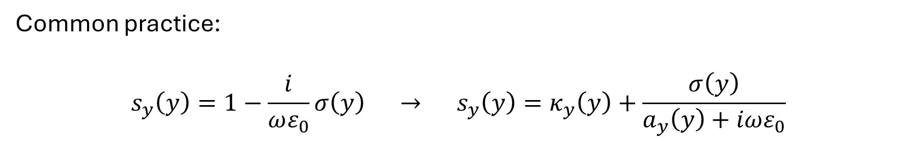
Stretched-coordinate formulation
Common practice:
$$s_{y}\left(y\right)=1−\frac{i}{ωε_{0}}σ\left(y\right) → s_{y}\left(y\right)=κ_{y}\left(y\right)+\frac{σ\left(y\right)}{a_{y}\left(y\right)+iωε_{0}}$$
Allows for more flexibility and efficient loss

Slide 54


Stretched-coordinate formulation
In the PML:
$$iωε_{0}εE_{x}=\frac{∂H_{z}}{∂\hat{y}}$$
$$iωμ_{0}H_{z}=\frac{∂E_{x}}{∂\hat{y}}$$
*use frequency domain because $\hat{y}$ depends on $ω$

Slide 55


Stretched-coordinate formulation
In the PML:
$$iωε_{0}εE_{x}=\frac{1}{s_{y}}\frac{∂H_{z}}{∂y}$$
$$iωμ_{0}H_{z}=\frac{1}{s_{y}}\frac{∂E_{y}}{∂y}$$
*use frequency domain because $s_{y}$ depends on $ω$

Slide 56



Stretched-coordinate formulation
Fourier Transform $ω→t$
$$ε_{0}ε\frac{{∂E}_{x}}{∂t}=\overline{s_{y}}∗\frac{∂H_{z}}{∂y}$$
$$μ_{0}\frac{∂H_{z}}{∂t}=\overline{s_{y}}∗\frac{∂E_{x}}{∂y}$$
only in the PML

Slide 57



Stretched-coordinate formulation
Convolution
$$ε_{0}ε\frac{{∂E}_{x}}{∂t}=\overline{s_{y}}\left(t\right)∗\frac{∂H_{z}}{∂y}$$
$$μ_{0}\frac{∂H_{z}}{∂t}=\overline{s_{y}}\left(t\right)∗\frac{∂E_{x}}{∂y}$$
$$\overline{s_{y}}\left(t\right)=FT\left(\frac{1}{s_{y}\left(ω\right)}\right)$$

Slide 58
CPML
CPML – an efficient way to solve these:
$$ε_{0}ε\frac{{∂E}_{x}}{∂t}=\overline{s_{y}}\left(t\right)∗\frac{∂H_{z}}{∂y}$$
$$μ_{0}\frac{∂H_{z}}{∂t}=\overline{s_{y}}\left(t\right)∗\frac{∂E_{x}}{∂y}$$
$$\overline{s_{y}}\left(t\right)=FT\left(\frac{1}{s_{y}\left(ω\right)}\right)$$

Slide 59

CPML
Using:
$$\overline{s_{y}}\left(t, y\right)=FT\left( \frac{1}{κ_{y}\left(y\right)+\frac{σ\left(y\right)}{a_{y}\left(y\right)+iωε_{0}}} \right)$$
And a bunch of math…

Slide 60
See Chapter 7.9 of Taflove & Hagness (3ed) for the math

Slide 61
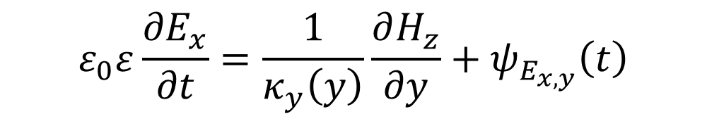
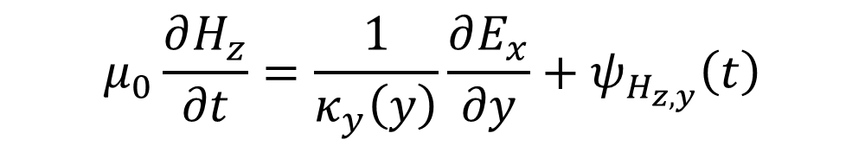
CPML
In the end we get:
$$ε_{0}ε\frac{{∂E}_{x}}{∂t}=\frac{1}{κ_{y}\left(y\right)}\frac{∂H_{z}}{∂y}+ψ_{E_{x,y}}\left(t\right)$$
$$μ_{0}\frac{∂H_{z}}{∂t}=\frac{1}{κ_{y}\left(y\right)}\frac{∂E_{x}}{∂y}+ψ_{H_{z,y}}\left(t\right)$$
*only in the PML

Slide 62


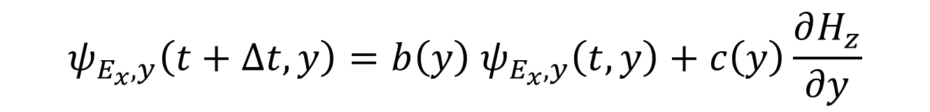

CPML
We get:
$$ε_{0}ε\frac{{∂E}_{x}}{∂t}=\frac{1}{κ_{y}}\frac{∂H_{z}}{∂y}+ψ_{E_{x},y}\left(t,y\right)$$
$$μ_{0}\frac{∂H_{z}}{∂t}=\frac{1}{κ_{y}}\frac{∂E_{x}}{∂y}+ψ_{H_{z},y}\left(t,y\right)$$
$$ψ_{E_{x},y}\left(t+Δt,y\right)=b\left(y\right) ψ_{E_{x},y}\left(t,y\right)+c\left(y\right)\frac{∂H_{z}}{∂y}$$

Slide 63

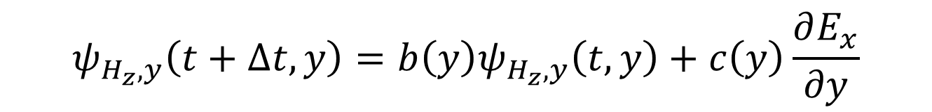
CPML
We get:
$$ε_{0}ε\frac{{∂E}_{x}}{∂t}=\frac{1}{κ_{y}}\frac{∂H_{z}}{∂y}+ψ_{E_{x},y}\left(t,y\right)$$
$$μ_{0}\frac{∂H_{z}}{∂t}=\frac{1}{κ_{y}}\frac{∂E_{x}}{∂y}+ψ_{H_{z},y}\left(t,y\right)$$
$$ψ_{E_{x},y}\left(t+Δt,y\right)=b\left(y\right) ψ_{E_{x},y}\left(t,y\right)+c\left(y\right)\frac{∂H_{z}}{∂y}$$
$$ψ_{H_{z},y}\left(t+Δt,y\right)=b\left(y\right)ψ_{H_{z},y}\left(t,y\right)+c\left(y\right)\frac{∂E_{x}}{∂y}$$

Slide 64

CPML
We get:
$$b\left(y\right)=\exp\left[−\left(\frac{σ_{y}\left(y\right)}{κ_{y}\left(y\right)}+a_{y}\left(y\right)\right)\frac{Δt}{ε_{0}}\right]$$
$$c\left(y\right)=\frac{σ\left(y\right)\left(b\left(y\right)−1\right)}{σ\left(y\right)κ_{y}\left(y\right)+κ_{y}^{2}\left(y\right)a_{y}\left(y\right)}$$

Slide 65


CPML
We get:
$$σ\left(y\right)=σ_{max}{\left(\frac{y}{l_{pml}}\right)}^{m}$$
$$κ_{y}\left(y\right)={1+(κ}_{max}−1){\left(\frac{y}{l_{pml}}\right)}^{m}$$
$$a_{y}\left(y\right)=a_{max}{\left(\frac{l_{pml}−y}{l_{pml}}\right)}^{m_{a}}$$
$$m \sim 3−5$$
$$m_{a} \sim 1−5$$
$$κ_{max} \sim 1−5$$
$$a_{max} \sim 0.1$$

Slide 66


CPML – Finite Differences
$$ε_{0}ε\frac{{∂E}_{x}}{∂t}=\frac{1}{κ_{y}}\frac{∂H_{z}}{∂y}+ψ_{E_{x},y}\left(t,y\right)$$
$$E_{x}\left(n+1,j\right)=E_{x}\left(n,j\right)+\frac{Δt}{ε_{0}ε}\left[\frac{H_{z}\left(n,j\right)−H_{z}\left(n,j−1\right)}{κ_{y}\left(j\right)Δy}+ψ_{E_{x},y}\left(n+1,j\right)\right]$$

Slide 67
CPML – Finite Differences
$$E_{x}\left(n+1,j\right)=E_{x}\left(n,j\right)+\frac{Δt}{ε_{0}ε}\left[\frac{H_{z}\left(n,j\right)−H_{z}\left(n,j−1\right)}{κ_{y}\left(j\right)Δy}+ψ_{E_{x},y}\left(n+1,j\right)\right]$$
$$ψ_{E_{x},y}\left(n+1,j\right)=b\left(j\right) ψ_{E_{x},y}\left(n,j\right)+c\left(j\right)\frac{H_{z}\left(n,j\right)−H_{z}\left(n,j−1\right)}{Δy}$$

Slide 68
CPML – Finite Differences
$$H_{z}\left(n+1,j\right)=H_{z}\left(n,j\right)+\frac{Δt}{μ_{0}}\left[\frac{E_{x}\left(n,j+1\right)−E_{x}\left(n,j\right)}{κ_{y}\left(j\right)Δy}+ψ_{H_{z},y}\left(n+1,j\right)\right]$$
$$ψ_{H_{z},y}\left(n+1,j\right)=b\left(j\right)ψ_{H_{z},y}\left(n,j\right)+c\left(j\right)\frac{E_{x}\left(n,j+1\right)−E_{x}\left(n,j\right)}{Δy}$$

Slide 69


Algorithm with CPML
Setup $σ_{y}\left(j\right),a_{y}\left(j\right),κ_{y}\left(j\right)→b\left(j\right), c\left(j\right)$
for $n=0→n_{max}:$
Update Magnetic field (n+1/2)
for $j=0→j_{max}−1:$
$$ψ_{H_{z},y}\left(n+1,j\right)=b\left(j\right)ψ_{H_{z},y}\left(n,j\right)+c\left(j\right)\frac{E_{x}\left(n,j+1\right)−E_{x}\left(n,j\right)}{Δy}$$
$$H_{z}\left(n+1,j\right)=H_{z}\left(n,j\right)+\frac{Δt}{μ_{0}}\left[\frac{E_{x}\left(n,j+1\right)−E_{x}\left(n,j\right)}{κ_{y}\left(j\right)Δy}+ψ_{H_{z},y}\left(n+1,j\right)\right]$$
Update Electric field (n+1)
for $j=1→j_{max}−1:$
$$ψ_{E_{x},y}\left(n+1,j\right)=b\left(j\right) ψ_{E_{x},y}\left(n,j\right)+c\left(j\right)\frac{H_{z}\left(n,j\right)−H_{z}\left(n,j−1\right)}{Δy}$$
$$E_{x}\left(n+1,j\right)=cE_{x}\left(n,j\right)+\frac{Δt}{ε_{0}ε}\left[\frac{H_{z}\left(n,j\right)−H_{z}\left(n,j−1\right)}{κ_{y}\left(y\right)Δy}+ψ_{H_{z},y}\left(n+1,j\right)\right]$$

Slide 70
Code break!

Slide 71
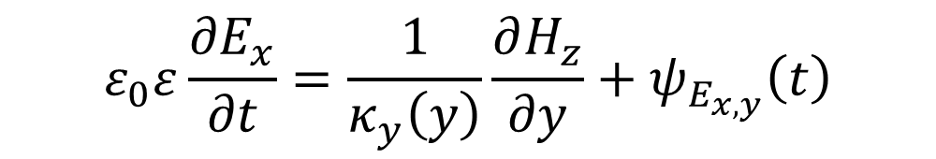
PMLs in 1D
$$ε_{0}ε\frac{{∂E}_{x}}{∂t}=\frac{1}{κ_{y}\left(y\right)}\frac{∂H_{z}}{∂y}+ψ_{E_{x,y}}\left(t\right)$$

Slide 72
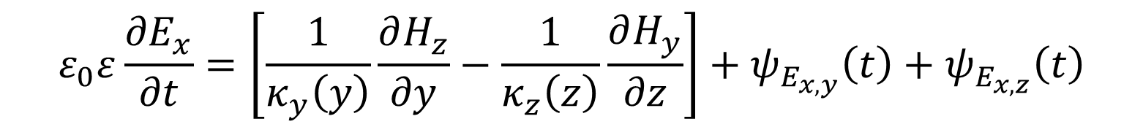
PMLs in 3D
$$ε_{0}ε\frac{{∂E}_{x}}{∂t}=\left[\frac{1}{κ_{y}\left(y\right)}\frac{∂H_{z}}{∂y}−\frac{1}{κ_{z}\left(z\right)}\frac{∂H_{y}}{∂z}\right]+ψ_{E_{x,y}}\left(t\right)+ψ_{E_{x,z}}\left(t\right)$$

Slide 73


PMLs in 3D
$$ε_{0}ε\frac{{∂E}_{x}}{∂t}=\left[\frac{1}{κ_{y}\left(y\right)}\frac{∂H_{z}}{∂y}−\frac{1}{κ_{z}\left(z\right)}\frac{∂H_{y}}{∂z}\right]+ψ_{E_{x,y}}\left(t\right)+ψ_{E_{x,z}}\left(t\right)$$
$$ψ_{E_{x,z}}$$
$$ψ_{E_{x,y}}$$
$$ψ_{E_{x,y}}$$
nanoparticle
$$z$$
$$ψ_{E_{x,z}}$$
$$y$$

Slide 74
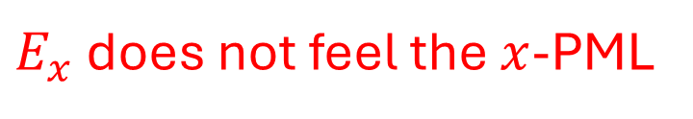
PMLs in 3D
$$ε_{0}ε\frac{{∂E}_{x}}{∂t}=\left[\frac{1}{κ_{y}\left(y\right)}\frac{∂H_{z}}{∂y}−\frac{1}{κ_{z}\left(z\right)}\frac{∂H_{y}}{∂z}\right]+ψ_{E_{x,y}}\left(t\right)+ψ_{E_{x,z}}\left(t\right)$$
$$ψ_{E_{x,z}}$$
$$ψ_{E_{x,y}}$$
$E_{x}$ does not feel the $x$-PML
$$ψ_{E_{x,y}}$$
nanoparticle
$$z$$
$$ψ_{E_{x,z}}$$
$$y$$

Slide 75
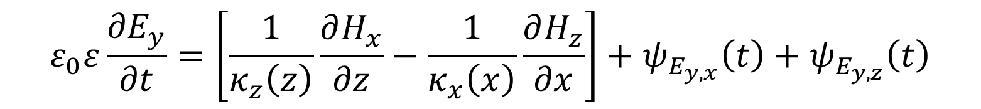
PMLs in 3D
$$ε_{0}ε\frac{{∂E}_{y}}{∂t}=\left[\frac{1}{κ_{z}\left(z\right)}\frac{∂H_{x}}{∂z}−\frac{1}{κ_{x}\left(x\right)}\frac{∂H_{z}}{∂x}\right]+ψ_{E_{y,x}}\left(t\right)+ψ_{E_{y,z}}\left(t\right)$$
$E_{y}$ only feels PMLs x and z-directions

Slide 76
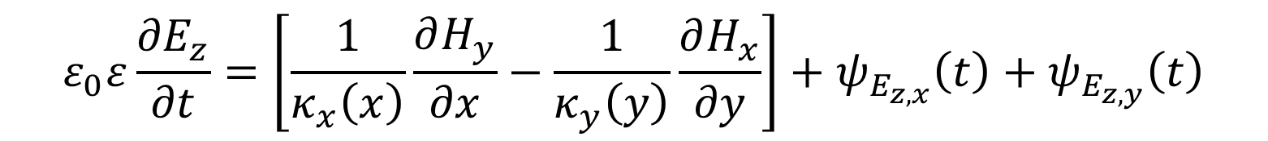
PMLs in 3D
$$ε_{0}ε\frac{{∂E}_{z}}{∂t}=\left[\frac{1}{κ_{x}\left(x\right)}\frac{∂H_{y}}{∂x}−\frac{1}{κ_{y}\left(y\right)}\frac{∂H_{x}}{∂y}\right]+ψ_{E_{z,x}}\left(t\right)+ψ_{E_{z,y}}\left(t\right)$$
$E_{z}$ only feels PMLs x and y-directions

Slide 77
PMLs in 3D
$E$ and $H$ field components only feel PMLs in the orthogonal directions
$E_{x}$ and $H_{x} →$ $y$ and $z$ PMLs
$E_{y}$ and $H_{y} →$ $x$ and $z$ PMLs
$E_{z}$ and $H_{z} →$ $x$ and $y$ PMLs

